Slide 1
Predicting Quality of Life Improvement for Obesity Patients in Rural Kansas
Olivia Rippee
Dr. Lexie Brown and Dr. Christie Befort
BIOS 898: Collaborative Research Experience

Slide 2
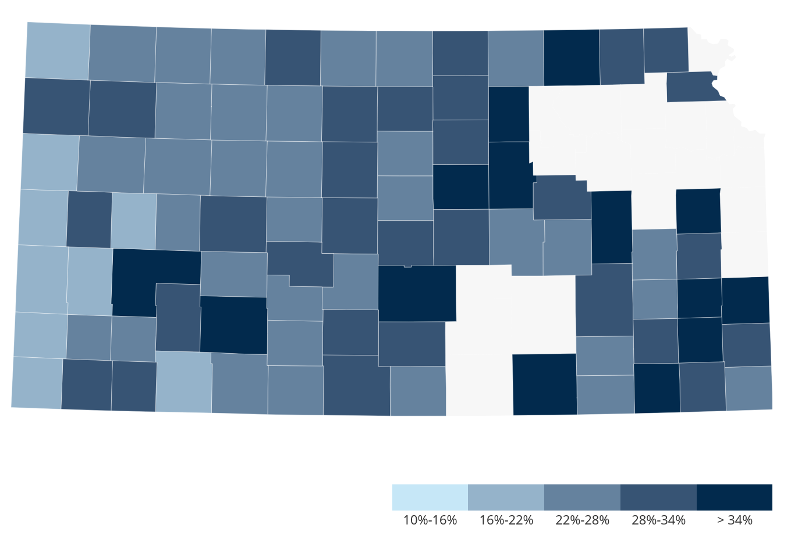
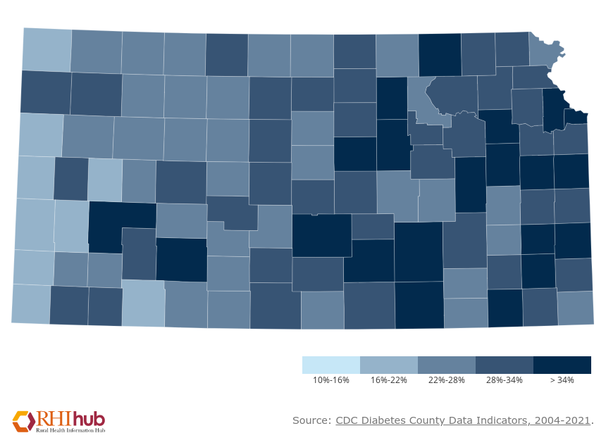
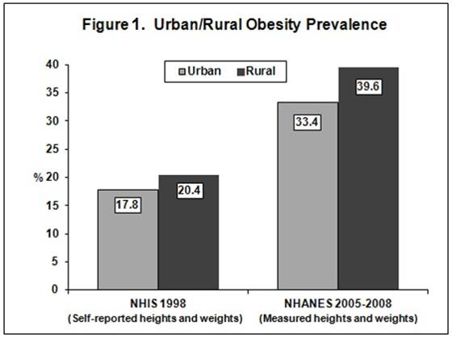


2
Study Background
Rural populations have higher prevalence of obesity, but poor access to weight loss programs
RE-POWER study: Cluster randomized clinical trial for rural obesity treatment
Study Phases
0-6 months treatment (regular meetings)
7-24 months follow-up (maintenance)
Notes:
Treatment arms
Fee-for-Service (FFS): in-clinic individual
Patient centered medical home (PCMH): in-clinic group
Disease Management (DM): phone group

Slide 3
3
Project Goal
Previous analyses
Which factors (including treatment group) causes the most weight loss?
Our research questions
What demographic and health factors (including weight loss) predict change
in quality of life?
Health: Percent weight loss, BMI, Mental health disorder(s), Comorbidities (2+)
Demographic: Gender, Age, Rurality

Slide 4
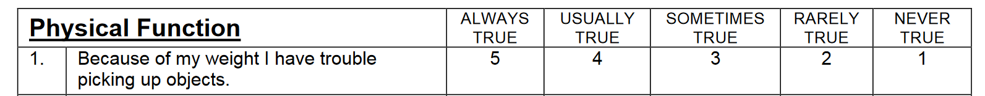
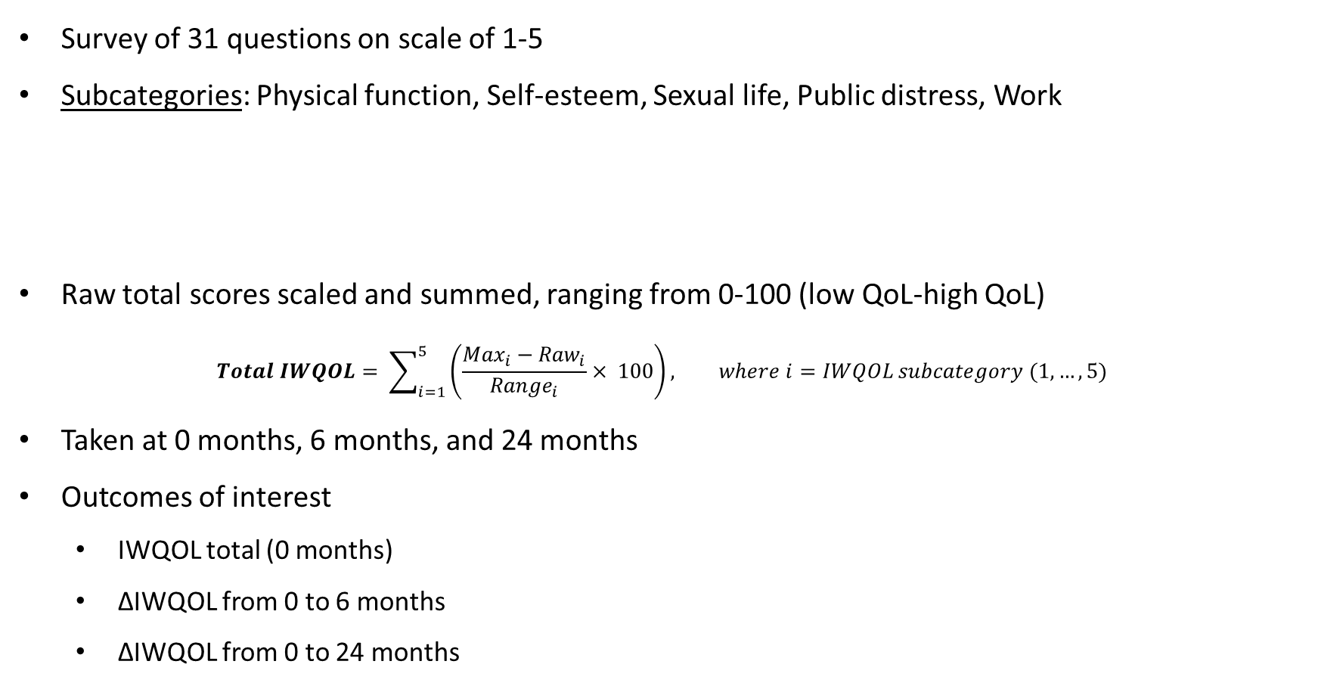
4
Impact of Weight on Quality of Life (IWQOL)
Survey of 31 questions on scale of 1-5
Subcategories: Physical function, Self-esteem, Sexual life, Public distress, Work
Raw total scores scaled and summed, ranging from 0-100 (low QoL-high QoL)
$$Total IWQOL= \sum_{i=1}^{5}{\left(\frac{{Max}_{i}−{Raw}_{i}}{{Range}_{i}}× 100\right)}, where i=IWQOL subcategory (1, …, 5)$$
Taken at 0 months, 6 months, and 24 months
Outcomes of interest
IWQOL total (0 months)
ΔIWQOL from 0 to 6 months
ΔIWQOL from 0 to 24 months
Notes:
(Always, Usually, Sometimes, Rarely, Never)

Slide 5
5
Modeling Strategy
Clinic stratification
Randomization at clinic level, stratified by affiliation (varying clinic size)
Mixed modeling
Site = Random effect
Affiliation = Fixed effect
Cross-sectional, not longitudinal
Univariate and multiple linear regression using demographic and health predictors

Slide 6
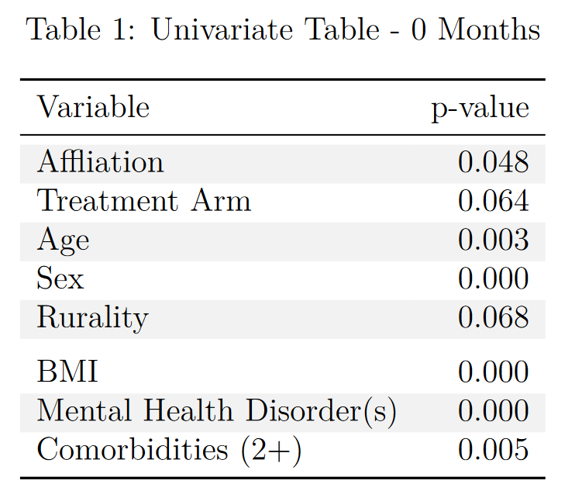
6
Univariate Linear Regression for IWQOL
Which baseline factors are significantly associated with IWQOL total score?
Variables considered for full model if univariate p-value ≤ 0.1

Slide 7
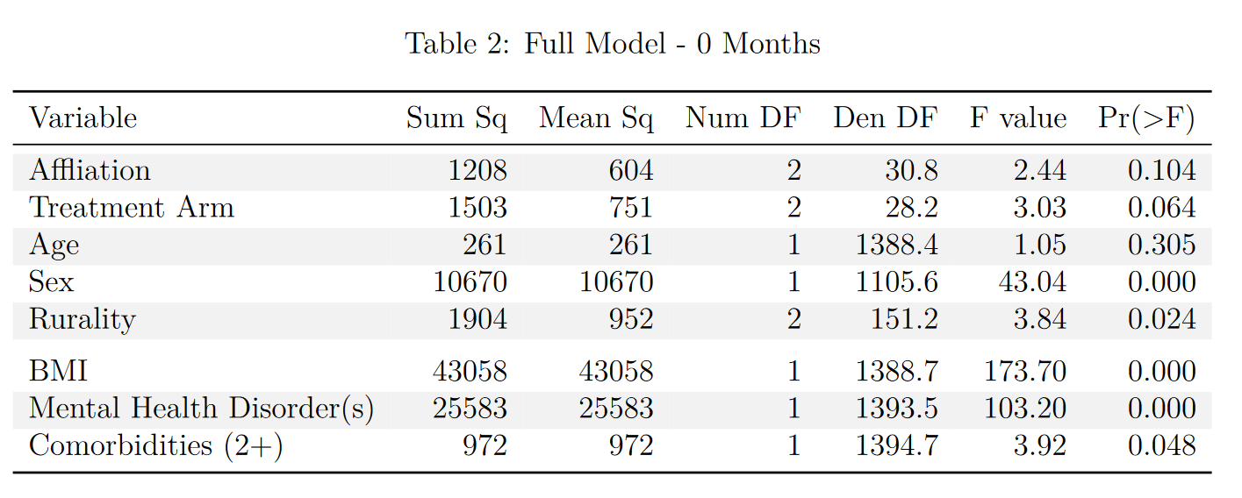


7
Multiple Linear Regression for IWQOL
Variables were removed via manual backwards selection until all variables had p-value ≤ 0.05.
Age (p = 0.305), comorbidities (p = 0.090), affiliation (p = 0.118), treatment arm (p = 0.105)

Slide 8
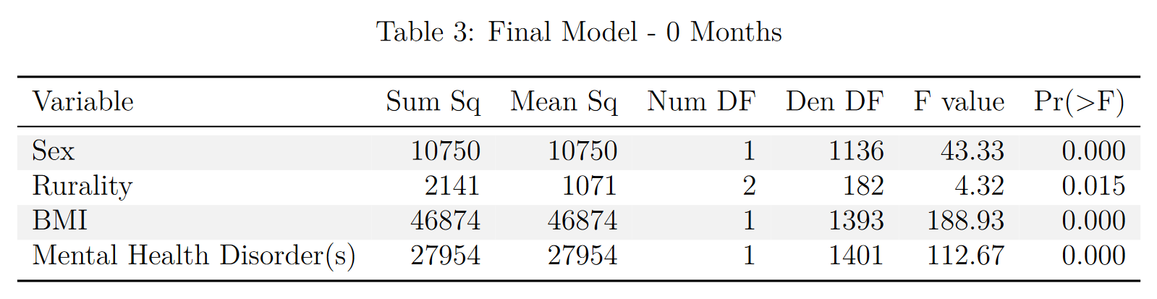
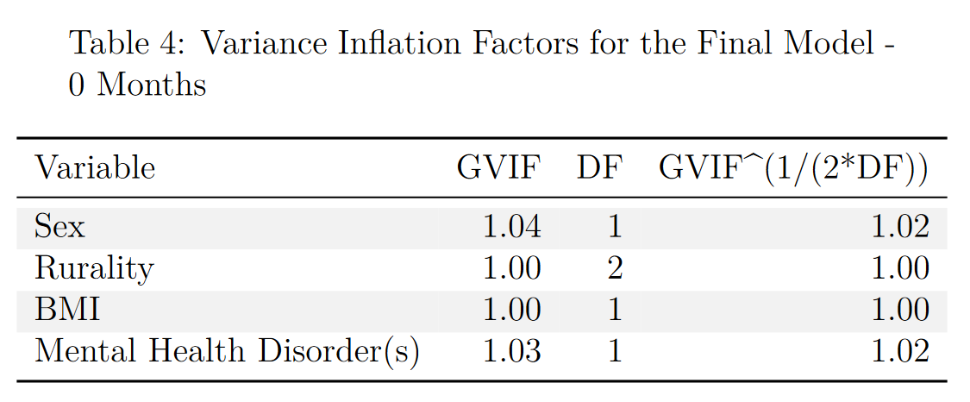
8
Multiple Linear Regression for IWQOL
GVIF for categorical with 3+ levels
GVIF < 5 → no multicollinearity

Slide 9
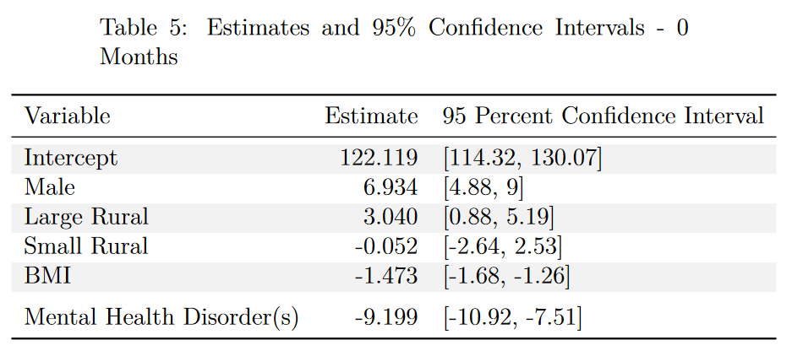
9
Multiple Linear Regression for IWQOL
Average baseline IWQOL total score for males was ~7 points higher than for females
Patients in large rural areas had IWQOL score ~3 points higher than isolated rural
No difference in IWQOL score between isolated rural and small rural
For a one-unit increase in BMI, baseline IWQOL score decreased by about 1.5 points
Average baseline IWQOL total score for patients a mental health disorder was ~9 points lower than for patients without

Slide 10
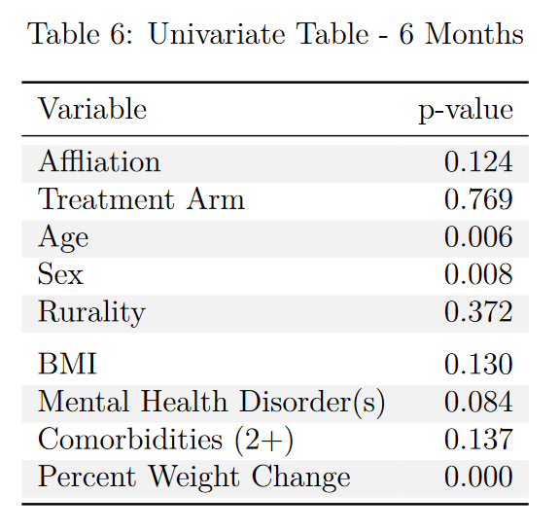








10
Univariate Linear Regression for ΔIWQOL
Which factors are significantly associated with change in IWQOL total score after the intensive treatment period (6 months)?
Variables considered for full model if univariate p-value ≤ 0.1

Slide 11
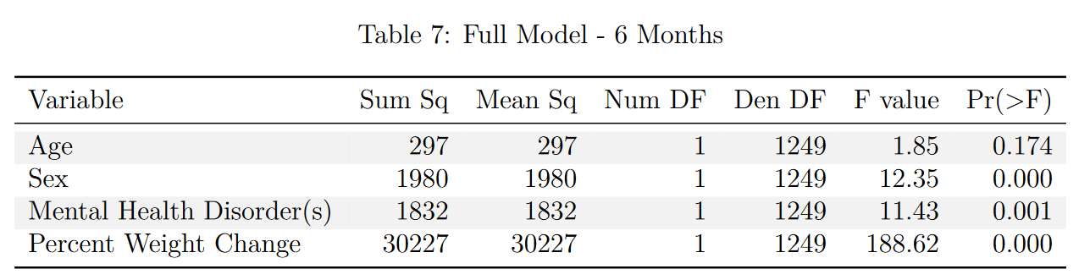


11
Multiple Linear Regression for ΔIWQOL
Only age was removed (p=0.174)

Slide 12
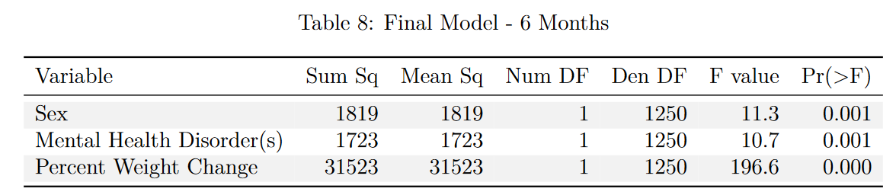
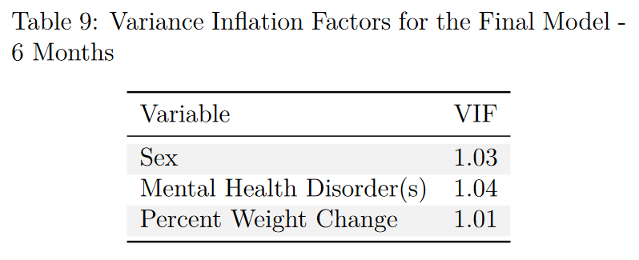
12
Multiple Linear Regression for ΔIWQOL
VIF < 5 → no multicollinearity

Slide 13
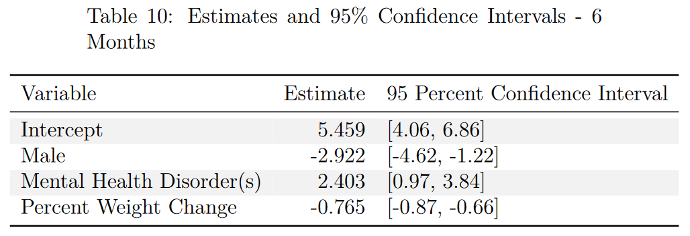
13
Multiple Linear Regression for ΔIWQOL
Average ΔIWQOL for males ~2.9 points lower than females (females ~2.9 points higher)
Females had a lower initial IWQOL; more room to improve
Average ΔIWQOL for patients with a mental health disorder was ~2.4 points higher than patients without
Patients with mental health disorders had a lower baseline IWQOL; more room to improve
1% weight loss = ΔIWQOL increased by ~0.8 points
Weight loss improves quality of life

Slide 14
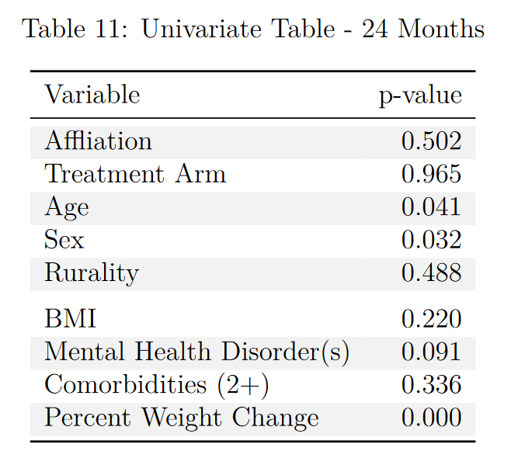








14
Univariate Linear Regression for ΔIWQOL
Which factors are significantly associated with change in IWQOL total score at the end of the study (24 months)?
Variables considered for full model if univariate p-value ≤ 0.1

Slide 15
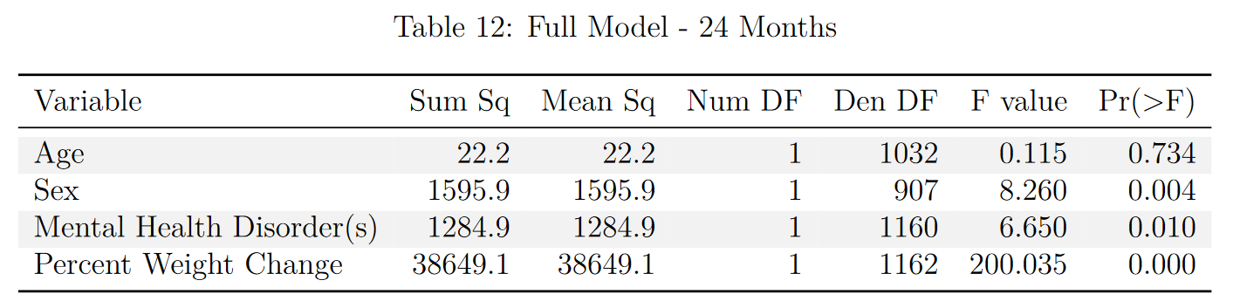


15
Multiple Linear Regression for ΔIWQOL
Only age was removed (p=0.734)

Slide 16
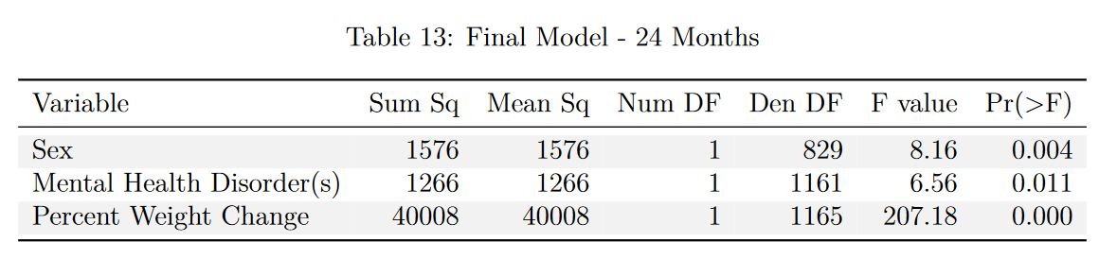
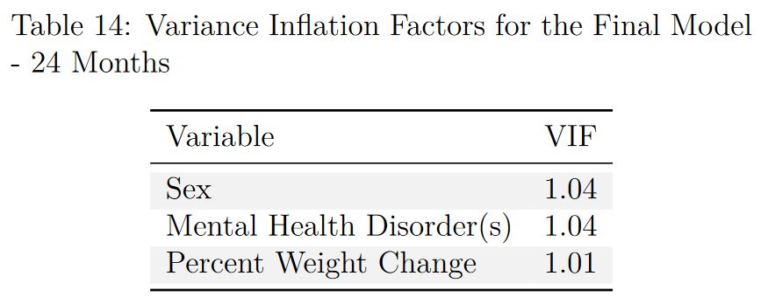
16
Multiple Linear Regression for ΔIWQOL
VIF < 5 → no multicollinearity

Slide 17
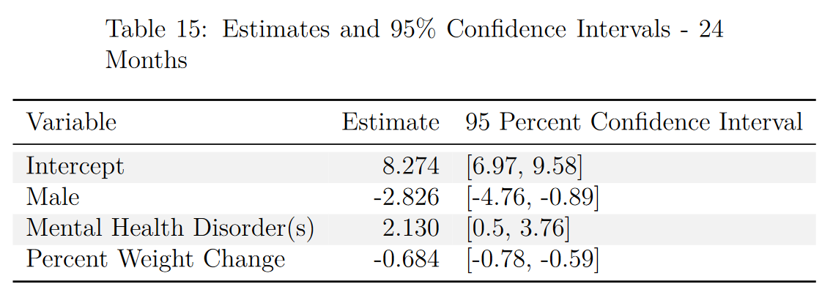
17
Multiple Linear Regression for ΔIWQOL
Average ΔIWQOL for males ~2.8 points lower than females (females ~2.8 points higher than males)
Average ΔIWQOL for patients with a mental health disorder was ~2 points higher than patients without
1% weight loss = ΔIWQOL increased by ~0.7 points
Weight loss improves quality of life

Slide 18
18
Conclusions
Many social determinants of health and medical conditions are associated with QoL
Key predictors of baseline IWQOL
Sex, mental health disorder status, BMI, and rurality
Key predictors of IWQOL improvement
Sex, mental health disorder status, and % weight change
Better understand and predict how effective weight loss clinical trials will be
Women and patients with mental health disorders have more quality of life to gain

Slide 19
19
Future Directions
Best subsets confirmation in SAS
Determine whether baseline quality of life affects percent weight change
Logistic regression for 5% and 10% weight loss (clinical cutoff)
IWQOL subcategory analysis
Which area(s) improved over the course of the study?

Slide 20
Thank you!
Questions?

